Slide 1
Cisco Certified Network Associate
(CCNA)

Slide 2
Module-1
Networking Essential& OSI Reference model

Slide 3
Overview
Introduction to Networking
Networking Devices
OSI model
TCP/IP Model

Slide 4




Introduction to Networking
Local Area Network
Wide Area Network

Slide 5
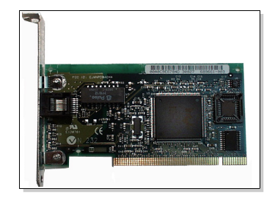
Host Connectivity

Slide 6
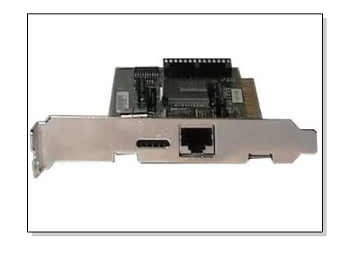
Host Connectivity

Slide 7
Network Adapters
Receive data and convert it into electrical signals
Receive electrical signals and convert them into data
Determine if the data received is for a particular computer
Control the flow of data through the cable

Slide 8
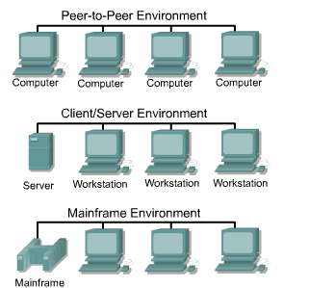
Peer-to-Peer

Slide 9
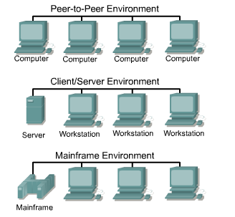
Client/Server

Slide 10

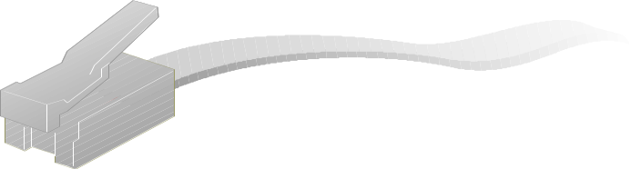

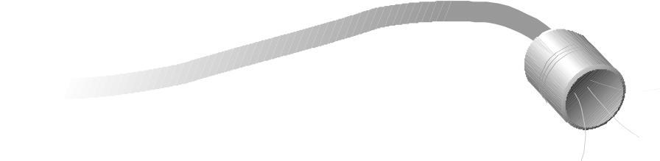


Network Cables
Twisted-Pair
Unshielded (UTP)
Shielded (STP)
10BaseT
Coaxial
ThinNet
ThickNet
10Base2, 10Base5
Fiber-Optic

Slide 11
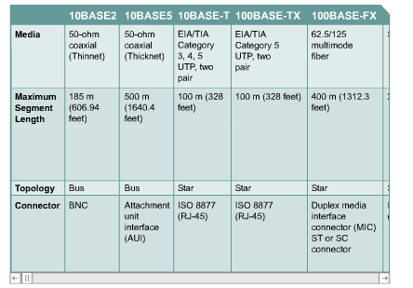
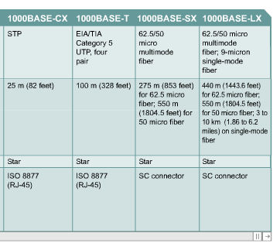
Ethernet Media and Connector Requirements

Slide 12
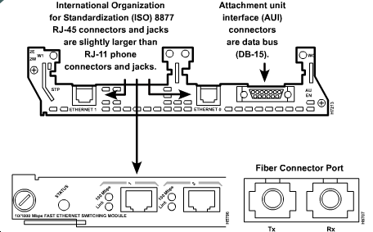
Connection Media

Slide 13
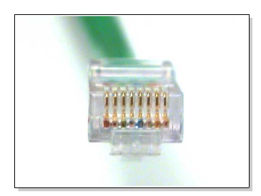
UTP Implementation

Slide 14
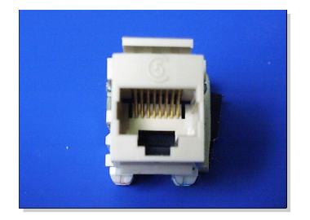
UTP Implementation

Slide 15
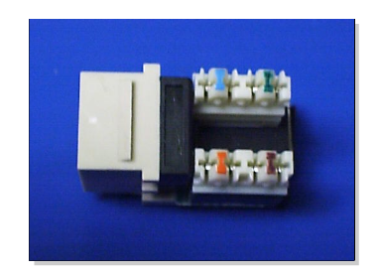
UTP Implementation

Slide 16
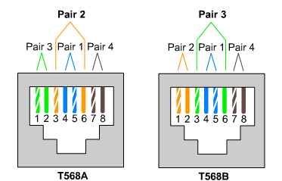
UTP Implementation

Slide 17
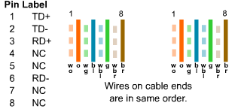
UTP Implementation

Slide 18
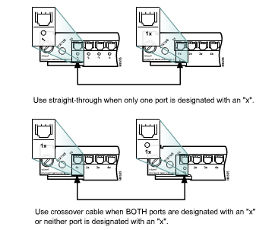
UTP Implementation

Slide 19
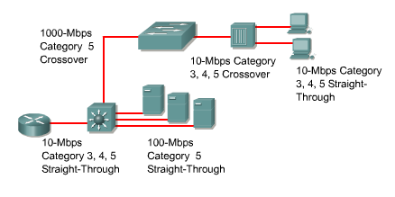
UTP Implementation

Slide 20
Networking Devices
Repeaters and Hubs
Bridges
Switches
Routers
Gateways

Slide 21
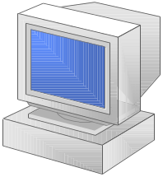
Repeaters and Hubs
Hub
Repeater

Slide 22
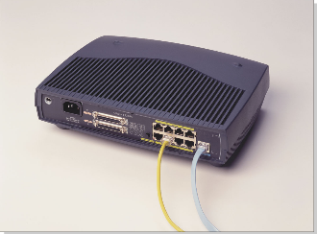
Hubs

Slide 23
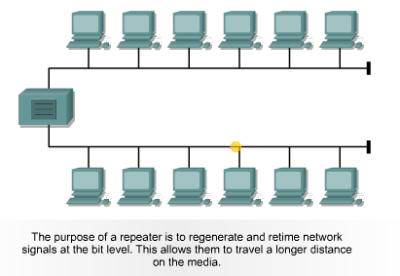
Repeaters

Slide 24
Bridges

Slide 25
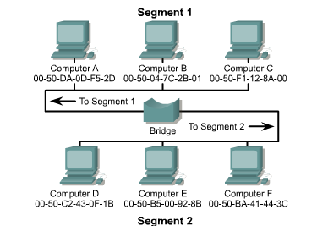
Bridges

Slide 26
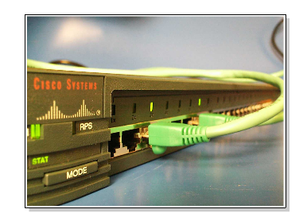
Switches

Slide 27
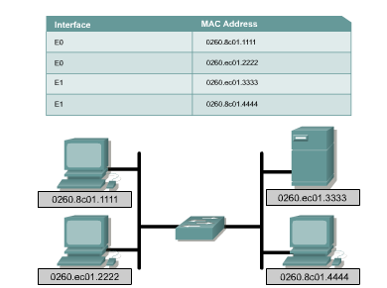
Switches

Slide 28
Switches

Slide 29


Routers

Slide 30
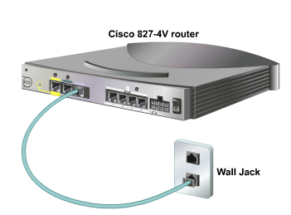
Routers and DSL Connections

Slide 31
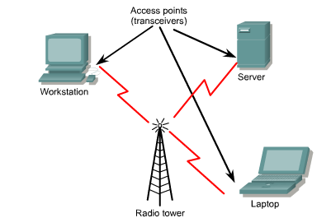
Wireless

Slide 32
Open Systems Interconnection (OSI)
Application Layer
Presentation Layer
Session Layer
Transport Layer
Network Layer
Data Link Layer
Physical Layer

Slide 33

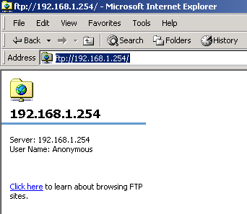
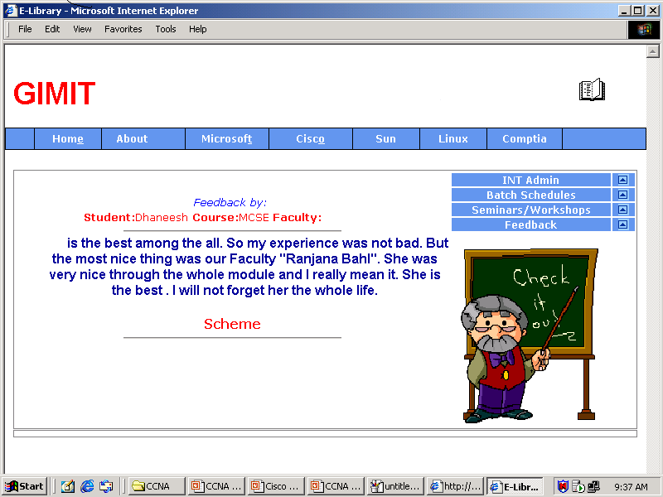
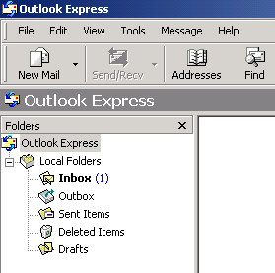
Application Layer
FTP Server
HTTP Server
SMTP Server

Slide 34
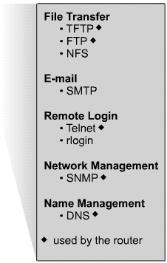
11.2.1 Introduction to the TCP/IP application layer
Domain Name System (DNS)
File Transfer Protocol (FTP)
Hypertext Transfer Protocol (HTTP)
Simple Mail Transfer Protocol (SMTP)
Simple Network Management Protocol (SNMP)
Telnet

Slide 35




Presentation Layer
The presentation of data to the proper application as
like MIDI, RTF, JPEG etc.

Slide 36
Session Layer
SQL
NCP
RPC

Slide 37

Transport Layer
TCP
UDP

Slide 38
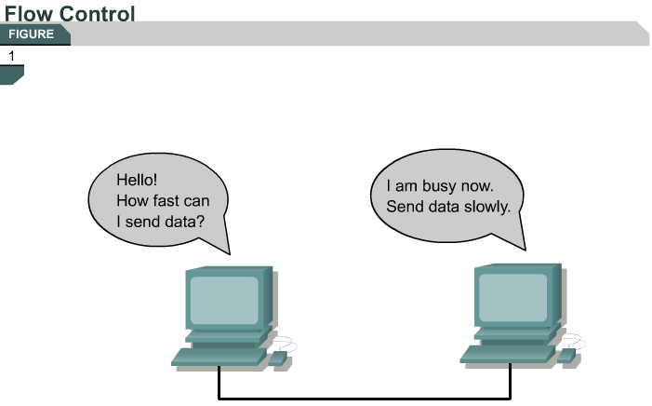

Slide 39
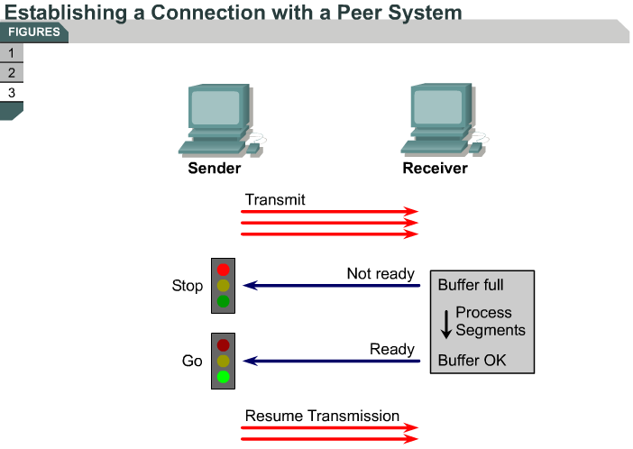
11.1.3 Session establishment, maintenance, and termination overview

Slide 40
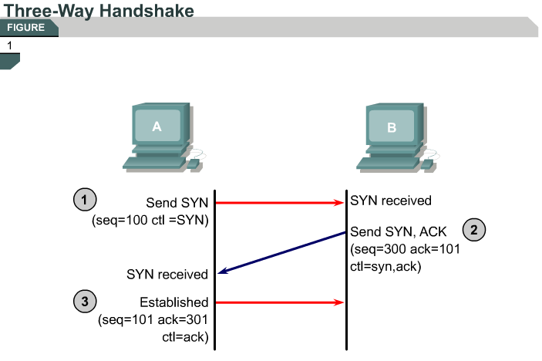
11.1.4 Three-way handshake

Slide 41
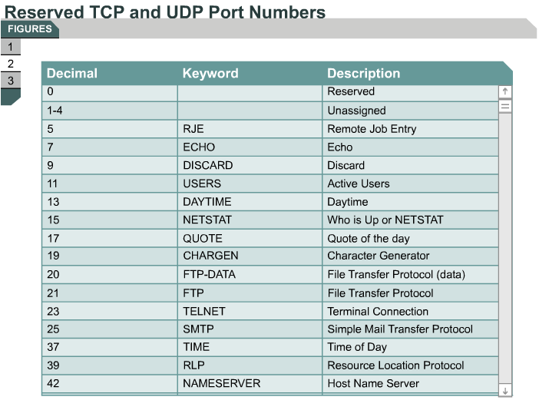
11.1.9 TCP and UDP port numbers

Slide 42
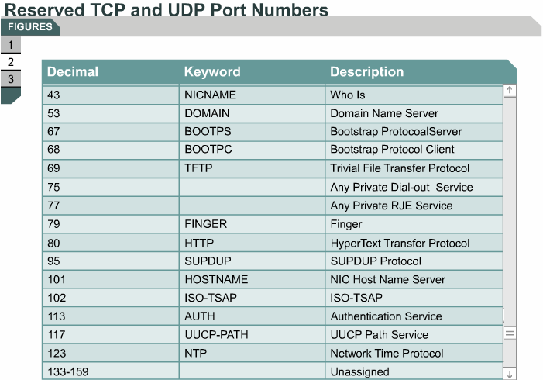
11.1.9 TCP and UDP port numbers

Slide 43
Network Layer
Router
Router
IP
IGMP
ICMP

Slide 44
Network Layer
1
B
ARP
Cache
5
2
A
3
ARP
Cache
6
C
4
1. ARP cache is checked
2. ARP request is sent
3. ARP entry is added
4. ARP reply is sent
5. ARP entry is added
6. IP packet is sent
ARP

Slide 45
Data Link Layer
Header
Data
Trailer
0.5 KB - 4 KB
CRC
Source
Address
Alert Signal
Destination
Address

Slide 46
Physical Layer
Ethernet
Token Ring
Asynchronous Transfer Mode (ATM)
Fiber Distributed Data Interface (FDDI)
Frame Relay

Slide 47

Ethernet
Carrier Sense Multiple Access
Collision Detection
Transmits signal
Detects signal
Collision detected
Characteristics
Description
Access Method
CSMA/CD
Transfer Speed
Standard Ethernet – 10 Mbps
Fast Ethernet – 100 Mbps
Gigabit Ethernet – 1 Gbps (1000 Mbps)

Slide 48

Token Ring
Physical
Ring
Logical
Ring
MSAU
Characteristics
Description
Access Method
Token passing
Transfer Speed
4 to 16 Mbps for all cable types

Slide 49
Asynchronous Transfer Mode
ATM
Switch
Cell
ATM
Switch
ATM
Switch
Cell
Characteristics
Description
Access Method
Point-to-point. Transfers fixed-sized packets from one computer to another through ATM switching equipment
Transfer Speed
Fiber-optic at 155 Mbps to 622 Mbps

Slide 50
Fiber Distributed Data Interface
Secondary Ring
Primary Ring
Characteristics
Description
Access Method
Token passing
Transfer Speed
Fiber-optic at 155 Mbps to 622 Mbps

Slide 51




Frame Relay
Main Office
Frame Relay Network
Frame
Branch Offices
Frame
Frame
Characteristics
Description
Access Method
Point-to-point
Transfer Speed
Dependent upon transmittal capabilities of digital leased lines

Slide 52
TCP/IP Protocol Suite
OSI Model
TCP/IP Model
TCP/IP Protocol Suite
7
6
5
4
3
2
1
Application
Application
Presentation
Session
Telnet
FTP
SMTP
DNS
RIP
SNMP
Transport
Layer
TCP
UDP
Transport
IP
Network
Network
IGMP
ICMP
ARP
Data link
Data link
Ethernet
Token
Ring
Frame
Relay
ATM
Physical
Physical

Slide 53
Practice Session

Slide 54
Review
Scope of Networks
Basic Connectivity Components
OSI MODEL
TCP /IP MODEL
Network Technologies
Expanding the Network

